Slide 1
The Tertiary Prep Programme Transitioning from Secondary to Tertiary Education
Senga White
SLANZA Conference - September 2015

Slide 2
The Tertiary Prep Programme
Flexible, tutorial-style sessions
Supports independent learning
Highlights critical thinking

Slide 3
The Tertiary Prep Programme
Managing Self
Managing Research
Managing Information
Managing Resources
Managing Study

Slide 4
TPT Session 1
Managing Self
http://bit.ly/1J8ynKW

Slide 5
The Tertiary Prep Programme
Session 1:
Managing Self
Time management
Personal organisation
Differences between secondary & tertiary learning
Learning styles
Memory techniques

Slide 6
TPT Session 2
Managing Research
http://bit.ly/1e6ScHN

Slide 7
The Tertiary Prep Programme
Session 2:
Managing Research
Research process
Google search strategies
Using databases

Slide 8
TPT Session 3
Managing Information
http://bit.ly/1NkVun0

Slide 9
The Tertiary Prep Programme
Session 3:
Managing Information
Note taking
Note making
Revising with notes
Essay writing

Slide 10
TPT Session 4
Managing Resources
http://bit.ly/1BQ0Rtj

Slide 11
The Tertiary Prep Programme
Session 4:
Managing Resources
Evaluating information
Using academic libraries
Curating resources

Slide 12
TPT Session 5
Managing Study
http://bit.ly/1djyGqS

Slide 13
The Tertiary Prep Programme
Session 5:
Managing Study
Planning for study
Exam preparation
Study tips

Slide 14
Origins of Tertiary Prep
Part of a wider information literacy approach
Research began in 2009
Redeveloped in 2013 for new school
2015 version designed for wider use
Trialled in 2010
Refined in 2014

Slide 15
The Research
“The gap between secondary and tertiary education in terms of literacy and the learning environment is bigger than anyone is acknowledging.”
Emerson, Kilpin & Feekery (2015)

Slide 16
The Research
Issue 1 Independent learning skills
Issue 2 Disconnect between sectors
Issue 3
Level of Information Literacy not robust

Slide 17
The Research
Factor 1 Pressures around NCEA
Factor 2
Lack of communication between sectors
Factor 3 Fundamental understanding about the nature of literacy

Slide 18
Tertiary Prep – The bigger picture

Slide 19
Information Literacy Framework

Slide 20
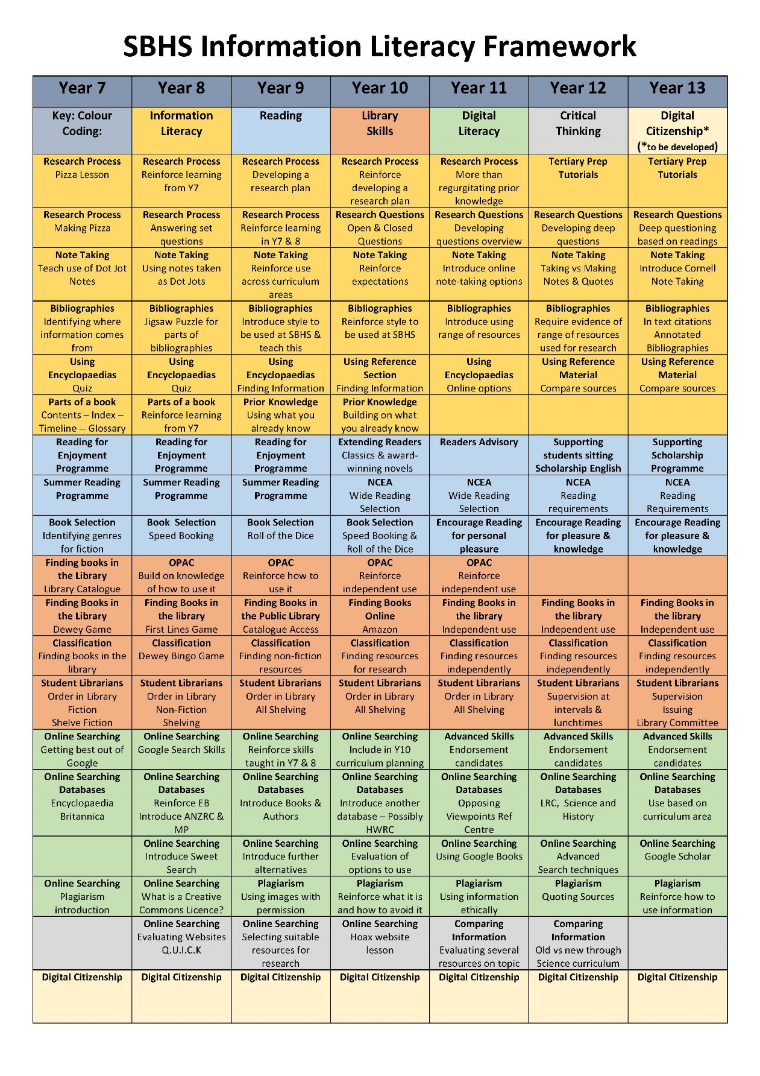

Slide 21
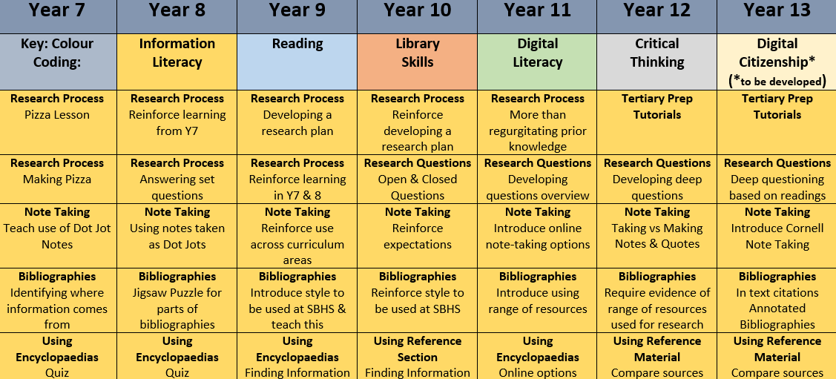
Information Literacy Skills

Slide 22
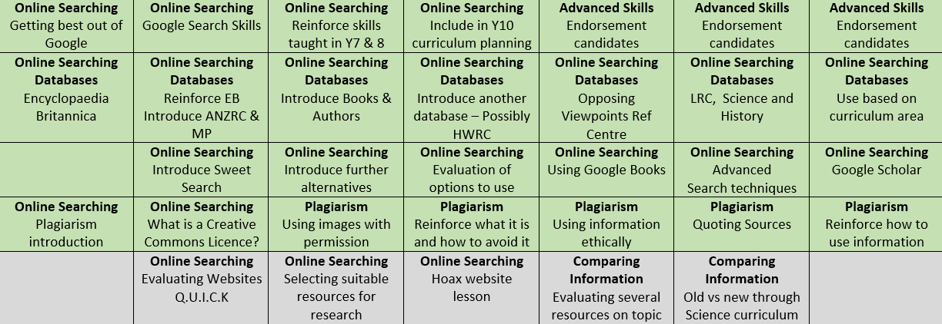
Information Literacy Skills

Slide 23
Things to Consider
Who do I need to talk to?
How could Tertiary Prep fit into my school?
Does my school need the whole programme?
What skills are we already teaching?
Do students have information literacy skills?
Should I involve our local tertiary institution?

Slide 25
Next Steps in 2016
Add up to three new sessions
Implement High Achievers Programme
Offer programme to the community
Increase evidence gathering
Investigate potential research initiatives

Slide 26
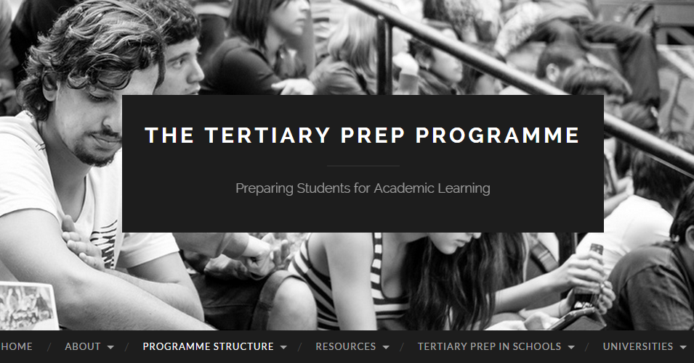
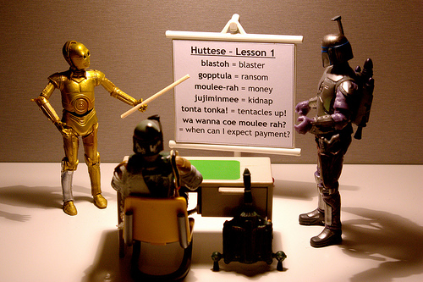
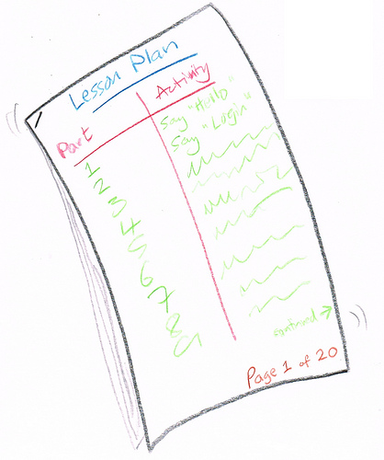
Tertiary Prep Resources
The Website
The Livebinder
Presentations
Lessons

Slide 27
What Next???

Slide 28
Senga White
Contact details:
Email: sengaw@windowslive.com
Twitter: @motherofwinter
Websites: sengawhite.nz
tertiaryprep.nz
Notes:
Article on Tertiary Prep Unit in SLANZA Collected Magazine Term 4, 2011 http://issuu.com/miriamtuohy/docs/november2011/1

Slide 29
Images
https://www.flickr.com/photos/francisco_osorio/13475151983/sizes/m/
https://www.flickr.com/photos/jonathancohen/8555554515/sizes/l
https://www.flickr.com/photos/darwinbell/8107066922/sizes/l
https://www.flickr.com/photos/pinksherbet/179279964/sizes/o/
https://www.flickr.com/photos/hippie/2476622740/sizes/l
https://www.flickr.com/photos/st3f4n/5422493992/sizes/m/
https://www.flickr.com/photos/bartelomeus/4184705426/sizes/m/
https://www.flickr.com/photos/terryfreedman/16490947256/sizes/m/
https://www.flickr.com/photos/anned/8700093610/sizes/c/
https://www.flickr.com/photos/sweetone/6416417037/sizes/l/in/photostream/
https://www.flickr.com/photos/wingedwolf/5471047557/sizes/o/
https://www.flickr.com/photos/infomastern/11855274335/sizes/sq/

